Slide 1
Movie
Recommendation
With Machine Learning

Slide 2
Table Of Content
Overview
Understanding the problems
Project objective
WorkFlow
Working
Visualisation
Project Output

Slide 3
Overview
The Movie Recommendation System project is a comprehensive solution designed to enhance movie watching experience for enthusiasts. This system uses web scraping technology to collect a wealth of information about movies from IMDb, including basic information such as titles, release years, genres, ratings, directors, etc. Careful data storage after data collection ensures dataset quality and reliability. This purified data is then used to train a linear regression model, which allows for the prediction of the number of movies based on various criteria, including genre and runtime At the core of the project is a planned web service providing real-time movie recommendations to users. Users can customize, specify minimum ratings and movie options, and receive personalized movie recommendations. This project is a pre-processing, machine learning, and web service systems, aimed at providing them with well-crafted and engaging movie recommendations the use of User-based or collaborative filtering algorithms in future enhancements.

Slide 4
Understanding the problems
::
In an era of so many movie choices, the problem of finding relevant and interesting movies that match their personal preferences remains a major challenge for fans Often consumers attempts to wade through an overwhelming number of films, resulting in an overabundance of choice and poor viewing experiences. This problem is compounded by the lack of a personalized movie recommendation system that addresses only the specific user, such as number of preferences, preferred types of movies and consequently, the need to produce a movie is a sophisticated recommendation system that offers customized movie recommendations that use web scraping, data for usage and machine learning as well as users.

Slide 5
Project objective
Data Collection: Gather movie data from IMDb through web scraping.
Data Preprocessing: Clean and prepare the data for analysis.
Machine Learning Model: Build a linear regression model for movie rating prediction.
Enhanced User Experience: Improve the movie-watching experience by reducing information overload and providing tailored recommendations.

Slide 6
Workflow
Analysis and Elicitation
Model Building
Data Sourcing
And Cleaning
Live Deployment

Slide 7

Working
Persona 01
Data collection and Preprocessing
Data Collection: The model starts by collecting movie information from IMDb, capturing information such as movie titles, year of release, movie genres and ratings.
Data preprocessing: Collected data is rigorously stored and preprocessed to ensure data quality and accuracy. This includes dealing with missing values ​​and converting data.
Feature selection and pattern training
Feature selection: Relevant features (e.g., genre, runtime, year) are selected to determine how a movie will show. These elements act as inputs to the model.
Model training: Machine learning models, especially linear regression models, are trained on selected features and actual movie analysis. During training, the model learns the relationship between features and ratings

Slide 8
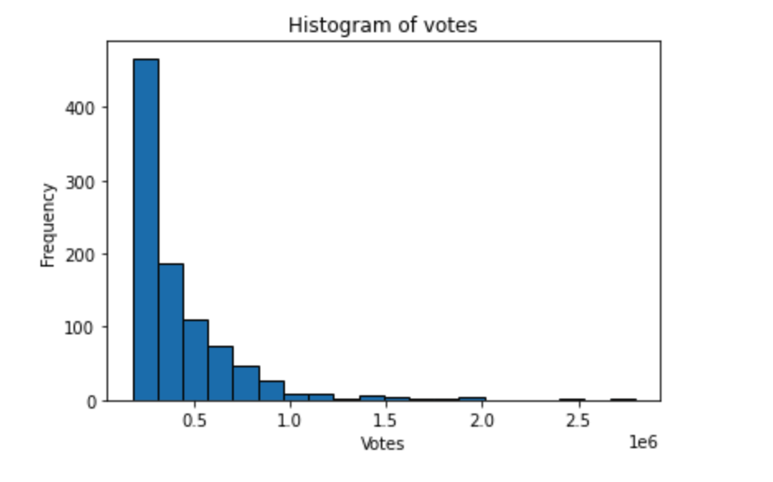

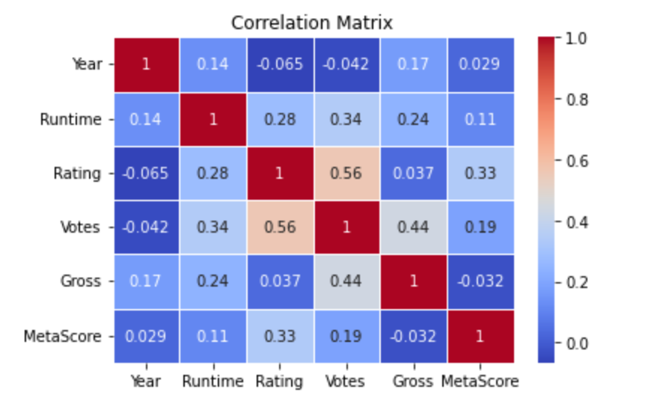
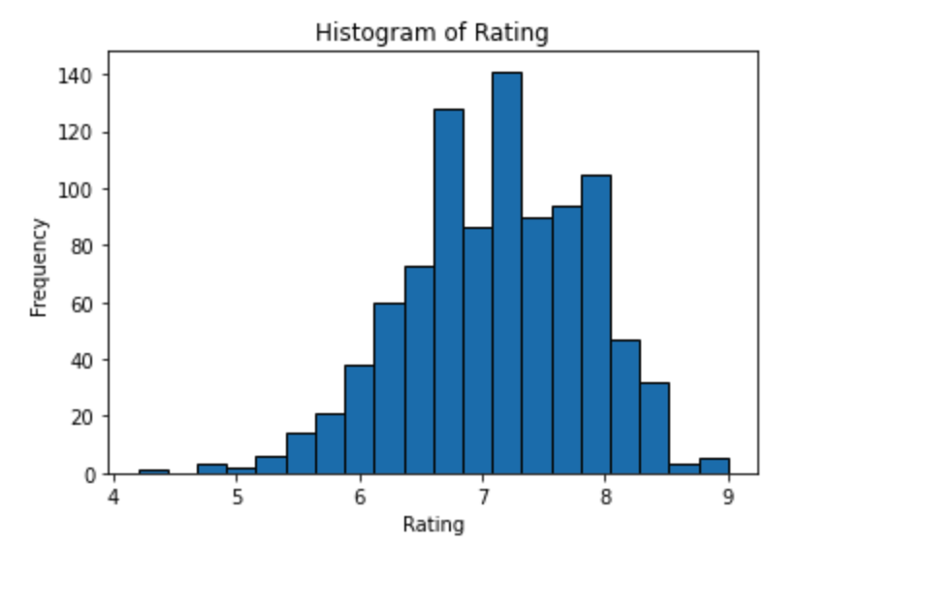
Visualisation

Slide 9
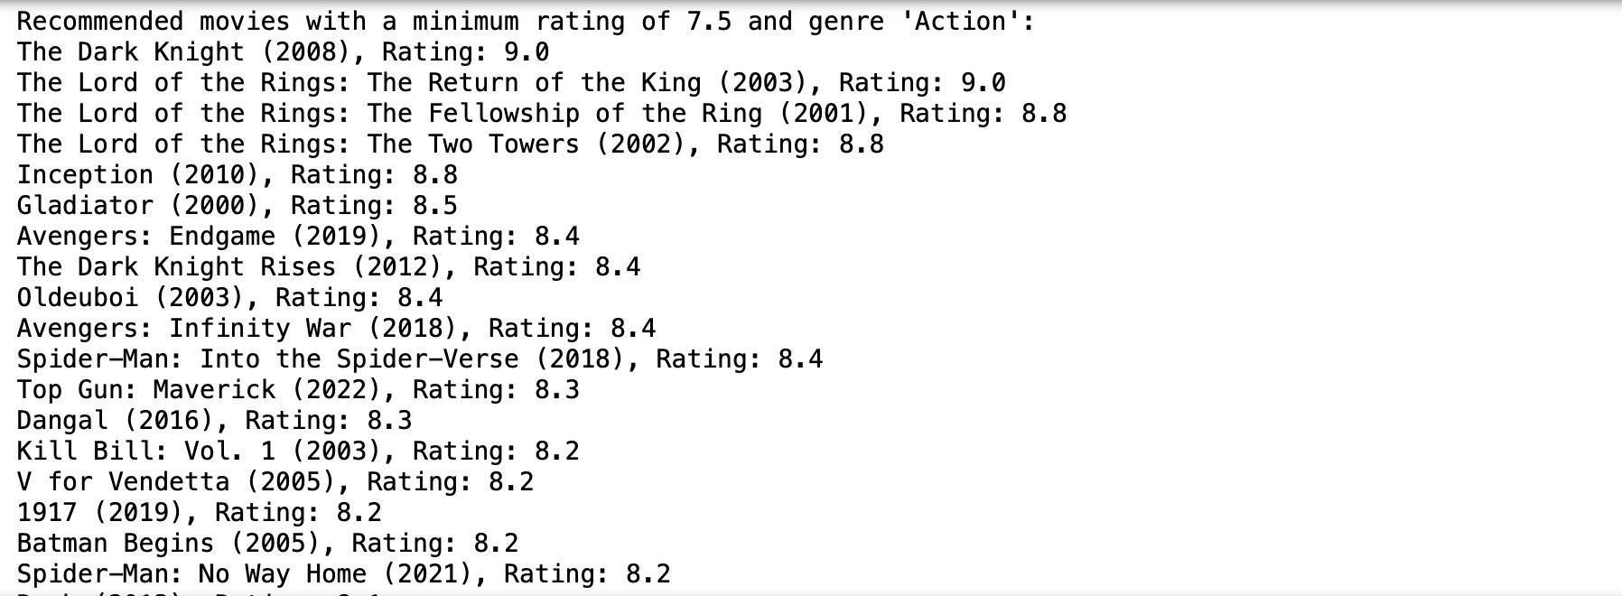
Project Output
Movie Rating above = 7.5
Genre = Action

Slide 10

Thank you!
Sadgi Jakhar
210BTCSEAM020

